Slide 1


Parameter Passing
by value
And
by reference

Slide 2


Slide 3


Slide 4
Real life Scenario 01
Suppose your laptop battery is damaged and you want to buy a new battery.
Notes:
Generally, Memory is also known as Main Memory, Primary Memory or RAM (Random Access Memory). This memory is divided into different Cells. Each cell has an address like we have the addresses of our houses or PO Boxes. CPU store the data into these cells and then loads data from these cells whenever it is required.

Slide 5
Real life Scenario 01
You take your laptop with you to Shop Center and the shop manager gives you a new battery according to your laptop.
Notes:
Generally, Memory is also known as Main Memory, Primary Memory or RAM (Random Access Memory). This memory is divided into different Cells. Each cell has an address like we have the addresses of our houses or PO Boxes. CPU store the data into these cells and then loads data from these cells whenever it is required.

Slide 6
Real life Scenario 01
You bring the battery home, replace the old battery with the new battery and everything starts working fine.
Notes:
Generally, Memory is also known as Main Memory, Primary Memory or RAM (Random Access Memory). This memory is divided into different Cells. Each cell has an address like we have the addresses of our houses or PO Boxes. CPU store the data into these cells and then loads data from these cells whenever it is required.

Slide 7
Real life Scenario 02
Now, again suppose your laptop battery is damaged and you want to buy a new battery.
Notes:
Generally, Memory is also known as Main Memory, Primary Memory or RAM (Random Access Memory). This memory is divided into different Cells. Each cell has an address like we have the addresses of our houses or PO Boxes. CPU store the data into these cells and then loads data from these cells whenever it is required.

Slide 8
Real life Scenario 02
Now, in this scenario you just call the Shop Center and tell them your house address and they come and fix your laptop.
Notes:
Generally, Memory is also known as Main Memory, Primary Memory or RAM (Random Access Memory). This memory is divided into different Cells. Each cell has an address like we have the addresses of our houses or PO Boxes. CPU store the data into these cells and then loads data from these cells whenever it is required.

Slide 9
In C++
Similarly, in C++, we can pass the complete variables to the functions (Pass by Value) or we can just pass the address of the variable (Pass by Reference).
Notes:
Generally, Memory is also known as Main Memory, Primary Memory or RAM (Random Access Memory). This memory is divided into different Cells. Each cell has an address like we have the addresses of our houses or PO Boxes. CPU store the data into these cells and then loads data from these cells whenever it is required.

Slide 10
In C++
Previously, we have already seen how we can pass the complete variables to the functions (Pass by Value).
Notes:
Generally, Memory is also known as Main Memory, Primary Memory or RAM (Random Access Memory). This memory is divided into different Cells. Each cell has an address like we have the addresses of our houses or PO Boxes. CPU store the data into these cells and then loads data from these cells whenever it is required.

Slide 11
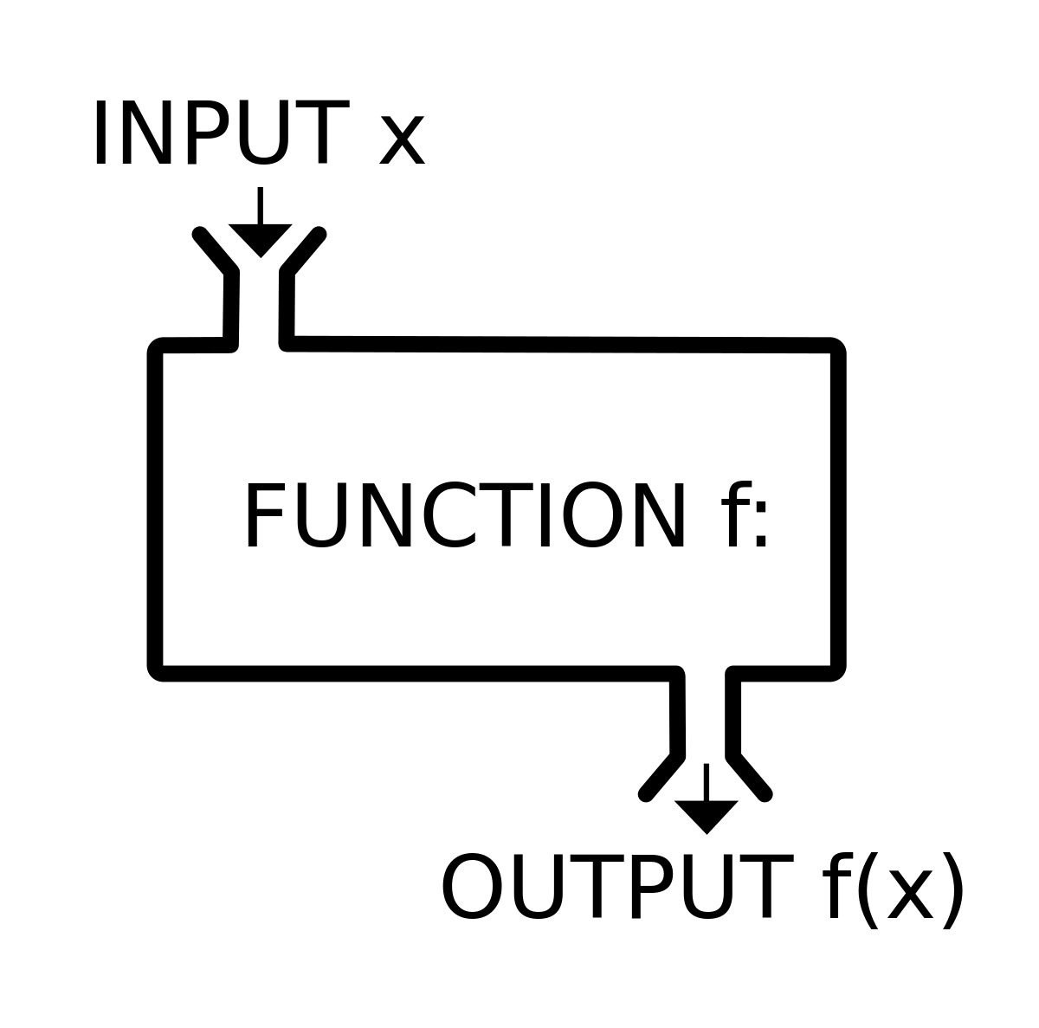
Review: Function in C++
Previously, we have written the function of Addition.
1 2 3 4 5 | int addition(int num1, int num2) { int sum = num1 + num2; return sum; }
Notes:
IS sawal main user sy 2 numbers ly ker un main sy larger number find kerna hia

Slide 12
Variables: Passing by Value
number1
0xE4A71
number2
0xE4A75
0xE4A79
1 2 3 4 5 6 7 8 9 | main(){ int number1, number2, result; cout << "Enter First Number: "; cin >> number1; cout << "Enter Second Number: "; cin >> number2; result = addition(number1, number2); cout << "Sum is: " << result; }
0xE4A83
Memory
1 2 3 4 5 | int addition(int num1, int num2) { int sum = num1 + num2; return sum; }
Function Call
Notes:
Generally, Memory is also known as Main Memory, Primary Memory or RAM (Random Access Memory). This memory is divided into different Cells. Each cell has an address like we have the addresses of our houses or PO Boxes. CPU store the data into these cells and then loads data from these cells whenever it is required.

Slide 13
Variables: Passing by Value
number1
7
0xE4A71
number2
5
0xE4A75
0xE4A79
1 2 3 4 5 6 7 8 9 | main(){ int number1, number2, result; cout << "Enter First Number: "; cin >> number1; cout << "Enter Second Number: "; cin >> number2; result = addition(number1, number2); cout << "Sum is: " << result; }
0xE4A83
Memory
1 2 3 4 5 | int addition(int num1, int num2) { int sum = num1 + num2; return sum; }
Function Call
Notes:
Generally, Memory is also known as Main Memory, Primary Memory or RAM (Random Access Memory). This memory is divided into different Cells. Each cell has an address like we have the addresses of our houses or PO Boxes. CPU store the data into these cells and then loads data from these cells whenever it is required.

Slide 14
Variables: Passing by Value
number1
7
0xE4A71
number2
5
0xE4A75
num1
7
0xE4A79
1 2 3 4 5 6 7 8 9 | main(){ int number1, number2, result; cout << "Enter First Number: "; cin >> number1; cout << "Enter Second Number: "; cin >> number2; result = addition(number1, number2); cout << "Sum is: " << result; }
num2
5
0xE4A83
Memory
1 2 3 4 5 | int addition(int num1, int num2) { int sum = num1 + num2; return sum; }
Function Call
Notes:
Generally, Memory is also known as Main Memory, Primary Memory or RAM (Random Access Memory). This memory is divided into different Cells. Each cell has an address like we have the addresses of our houses or PO Boxes. CPU store the data into these cells and then loads data from these cells whenever it is required.

Slide 15
Variables: Passing by Value
After the function call, the local variables of the addition function will be destroyed and only the variables of the main function will remain.
number1
7
0xE4A71
number2
5
0xE4A75
0xE4A79
1 2 3 4 5 6 7 8 9 | main(){ int number1, number2, result; cout << "Enter First Number: "; cin >> number1; cout << "Enter Second Number: "; cin >> number2; result = addition(number1, number2); cout << "Sum is: " << result; }
0xE4A83
Memory
1 2 3 4 5 | int addition(int num1, int num2) { int sum = num1 + num2; return sum; }
Function Call
Notes:
Generally, Memory is also known as Main Memory, Primary Memory or RAM (Random Access Memory). This memory is divided into different Cells. Each cell has an address like we have the addresses of our houses or PO Boxes. CPU store the data into these cells and then loads data from these cells whenever it is required.

Slide 16
In C++
Let’s see how we can just pass the address of the variable (Pass by Reference).
Notes:
Generally, Memory is also known as Main Memory, Primary Memory or RAM (Random Access Memory). This memory is divided into different Cells. Each cell has an address like we have the addresses of our houses or PO Boxes. CPU store the data into these cells and then loads data from these cells whenever it is required.

Slide 17
Function in C++
Now, the Addition function is
only receiving the address of the variables.
1 2 3 4 5 | int addition(int &num1, int &num2) { int sum = num1 + num2; return sum; }
Notes:
IS sawal main user sy 2 numbers ly ker un main sy larger number find kerna hia

Slide 18
Variables: Passing by Reference
number1
7
0xE4A71
number2
5
0xE4A75
0xE4A79
1 2 3 4 5 6 7 8 9 | main(){ int number1, number2, result; cout << "Enter First Number: "; cin >> number1; cout << "Enter Second Number: "; cin >> number2; result = addition(number1, number2); cout << "Sum is: " << result; }
0xE4A83
Memory
1 2 3 4 5 | int addition(int &num1, int &num2) { int sum = num1 + num2; return sum; }
Function Call
Notes:
Generally, Memory is also known as Main Memory, Primary Memory or RAM (Random Access Memory). This memory is divided into different Cells. Each cell has an address like we have the addresses of our houses or PO Boxes. CPU store the data into these cells and then loads data from these cells whenever it is required.

Slide 19
Variables: Passing by Reference
number1
7
0xE4A71
number2
5
0xE4A75
num1
0xE4A71
0xE4A79
1 2 3 4 5 6 7 8 9 | main(){ int number1, number2, result; cout << "Enter First Number: "; cin >> number1; cout << "Enter Second Number: "; cin >> number2; result = addition(number1, number2); cout << "Sum is: " << result; }
num2
0xE4A75
0xE4A83
Memory
1 2 3 4 5 | int addition(int &num1, int &num2) { int sum = num1 + num2; return sum; }
Function Call
Notes:
Generally, Memory is also known as Main Memory, Primary Memory or RAM (Random Access Memory). This memory is divided into different Cells. Each cell has an address like we have the addresses of our houses or PO Boxes. CPU store the data into these cells and then loads data from these cells whenever it is required.

Slide 20
Variable passing by Value VS by Reference
When we use pass by reference and if the receiving function make any change in the variable the change will also visible to the caller. why?
int addition(int num1, int num2) { int sum = num1 + num2; num1 = 3 return sum; }
int addition(int &num1, int &num2) { int sum = num1 + num2; return sum; }
Pass by Reference
Pass by Value
Notes:
Generally, Memory is also known as Main Memory, Primary Memory or RAM (Random Access Memory). This memory is divided into different Cells. Each cell has an address like we have the addresses of our houses or PO Boxes. CPU store the data into these cells and then loads data from these cells whenever it is required.

Slide 21
Variable passing by Value VS by Reference
Both functions did the same job, but what was the benefit of passing the variable by reference?
int addition(int num1, int num2) { int sum = num1 + num2; return sum; }
int addition(int &num1, int &num2) { int sum = num1 + num2; return sum; }
Pass by Value
Pass by Reference
Notes:
Generally, Memory is also known as Main Memory, Primary Memory or RAM (Random Access Memory). This memory is divided into different Cells. Each cell has an address like we have the addresses of our houses or PO Boxes. CPU store the data into these cells and then loads data from these cells whenever it is required.

Slide 22
Variable passing by Reference
If we want to return multiple values from the function then we must pass the parameters by reference.
Notes:
Generally, Memory is also known as Main Memory, Primary Memory or RAM (Random Access Memory). This memory is divided into different Cells. Each cell has an address like we have the addresses of our houses or PO Boxes. CPU store the data into these cells and then loads data from these cells whenever it is required.

Slide 23
Variable passing by Reference
Let’s make our own Swap function by passing the parameters by reference.
void swapped(int &num1, int &num2)
{
int temp = num1;
num1 = num2;
num2 = temp;
}
Notes:
Generally, Memory is also known as Main Memory, Primary Memory or RAM (Random Access Memory). This memory is divided into different Cells. Each cell has an address like we have the addresses of our houses or PO Boxes. CPU store the data into these cells and then loads data from these cells whenever it is required.

Slide 24
Variable passing by Reference
number1
6
0xE4A71
number2
7
0xE4A75
0xE4A79
0xE4A83
Memory
main()
{
int number1 = 6, number2 = 7;
cout << number1 << " " << number2 << endl;
swapped(number1, number2);
cout << number1 << " " << number2;
}
void swapped(int &num1, int &num2)
{
int temp = num1;
num1 = num2;
num2 = temp;
}
Notes:
Generally, Memory is also known as Main Memory, Primary Memory or RAM (Random Access Memory). This memory is divided into different Cells. Each cell has an address like we have the addresses of our houses or PO Boxes. CPU store the data into these cells and then loads data from these cells whenever it is required.

Slide 25
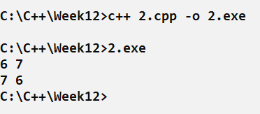
Variable passing by Reference
number1
6
0xE4A71
number2
7
0xE4A75
0xE4A79
0xE4A83
Memory
main()
{
int number1 = 6, number2 = 7;
cout << number1 << " " << number2 << endl;
swapped(number1, number2);
cout << number1 << " " << number2;
}
void swapped(int &num1, int &num2)
{
int temp = num1;
num1 = num2;
num2 = temp;
}
Notes:
Generally, Memory is also known as Main Memory, Primary Memory or RAM (Random Access Memory). This memory is divided into different Cells. Each cell has an address like we have the addresses of our houses or PO Boxes. CPU store the data into these cells and then loads data from these cells whenever it is required.

Slide 26
Variable passing by Reference
number1
6
0xE4A71
number2
7
0xE4A75
num1
0xE4A71
0xE4A79
num2
0xE4A75
0xE4A83
Memory
main()
{
int number1 = 6, number2 = 7;
cout << number1 << " " << number2 << endl;
swapped(number1, number2);
cout << number1 << " " << number2;
}
void swapped(int &num1, int &num2)
{
int temp = num1;
num1 = num2;
num2 = temp;
}
Notes:
Generally, Memory is also known as Main Memory, Primary Memory or RAM (Random Access Memory). This memory is divided into different Cells. Each cell has an address like we have the addresses of our houses or PO Boxes. CPU store the data into these cells and then loads data from these cells whenever it is required.

Slide 27
Variable passing by Reference
number1
7
0xE4A71
number2
6
0xE4A75
0xE4A79
0xE4A83
Memory
main()
{
int number1 = 6, number2 = 7;
cout << number1 << " " << number2 << endl;
swapped(number1, number2);
cout << number1 << " " << number2;
}
void swapped(int &num1, int &num2)
{
int temp = num1;
num1 = num2;
num2 = temp;
}
Notes:
Generally, Memory is also known as Main Memory, Primary Memory or RAM (Random Access Memory). This memory is divided into different Cells. Each cell has an address like we have the addresses of our houses or PO Boxes. CPU store the data into these cells and then loads data from these cells whenever it is required.

Slide 28
Real life Scenario 03
Now, suppose your room AC breaks down and it is not working.
Notes:
Generally, Memory is also known as Main Memory, Primary Memory or RAM (Random Access Memory). This memory is divided into different Cells. Each cell has an address like we have the addresses of our houses or PO Boxes. CPU store the data into these cells and then loads data from these cells whenever it is required.

Slide 29
Real life Scenario 03
Since it is a bigger item, therefore you do not take your AC to the Electrician.
Notes:
Generally, Memory is also known as Main Memory, Primary Memory or RAM (Random Access Memory). This memory is divided into different Cells. Each cell has an address like we have the addresses of our houses or PO Boxes. CPU store the data into these cells and then loads data from these cells whenever it is required.

Slide 30
Real life Scenario 03
You call the electrician and tell him the address of your house so he can come and repair your AC.
Notes:
Generally, Memory is also known as Main Memory, Primary Memory or RAM (Random Access Memory). This memory is divided into different Cells. Each cell has an address like we have the addresses of our houses or PO Boxes. CPU store the data into these cells and then loads data from these cells whenever it is required.

Slide 31
In C++
Since, in C++, arrays take large memory space and they are difficult to pass to the functions therefore we only pass their address i.e. we pass them by Reference.
0xE4A71
0xE4A75
0xE4A79
0xE4A83
0xE4A87
num
5 | 4 | 1 | 11 | 6
Notes:
Generally, Memory is also known as Main Memory, Primary Memory or RAM (Random Access Memory). This memory is divided into different Cells. Each cell has an address like we have the addresses of our houses or PO Boxes. CPU store the data into these cells and then loads data from these cells whenever it is required.

Slide 32
Arrays: Passing by Reference
Let’s see first what happens if we just cout the name of the array.
#include <iostream>
using namespace std;
main(){
int num[5] = {5, 4, 1, 11, 6};
cout << num;
}
0xE4A71
0xE4A75
0xE4A79
0xE4A83
0xE4A87
num
5 | 4 | 1 | 11 | 6
Notes:
Generally, Memory is also known as Main Memory, Primary Memory or RAM (Random Access Memory). This memory is divided into different Cells. Each cell has an address like we have the addresses of our houses or PO Boxes. CPU store the data into these cells and then loads data from these cells whenever it is required.

Slide 33
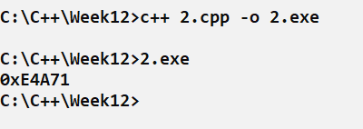
Arrays: Passing by Reference
Let’s see first what happens if we just cout the name of the array.
#include <iostream>
using namespace std;
main(){
int num[5] = {5, 4, 1, 11, 6};
cout << num;
}
0xE4A71
0xE4A75
0xE4A79
0xE4A83
0xE4A87
num
5 | 4 | 1 | 11 | 6
Notes:
Generally, Memory is also known as Main Memory, Primary Memory or RAM (Random Access Memory). This memory is divided into different Cells. Each cell has an address like we have the addresses of our houses or PO Boxes. CPU store the data into these cells and then loads data from these cells whenever it is required.

Slide 34
Arrays: Passing by Reference
It means if we just write the name of the array then we get the starting address of the array.
#include <iostream>
using namespace std;
main(){
int num[5] = {5, 4, 1, 11, 6};
cout << num;
}
0xE4A71
0xE4A75
0xE4A79
0xE4A83
0xE4A87
num
5 | 4 | 1 | 11 | 6
Notes:
Generally, Memory is also known as Main Memory, Primary Memory or RAM (Random Access Memory). This memory is divided into different Cells. Each cell has an address like we have the addresses of our houses or PO Boxes. CPU store the data into these cells and then loads data from these cells whenever it is required.

Slide 35
Arrays: Passing by Reference
Now, lets print this array after passing to printArray(int arr[], int size) function.
void printArray(int arr[], int size)
{
for(int x = 0; x < size; x++)
{
cout << arr[x] << " ";
}
}
#include <iostream>
using namespace std;
main(){
int num[5] = {5, 4, 1, 11, 6};
printArray(num, 5);
}
0xE4A71
0xE4A75
0xE4A79
0xE4A83
0xE4A87
num
5 | 4 | 1 | 11 | 6
Notes:
Generally, Memory is also known as Main Memory, Primary Memory or RAM (Random Access Memory). This memory is divided into different Cells. Each cell has an address like we have the addresses of our houses or PO Boxes. CPU store the data into these cells and then loads data from these cells whenever it is required.

Slide 36
Arrays: Passing by Reference
We just passed the starting address of the array to the function instead of passing the complete array.
void printArray(int arr[], int size)
{
for(int x = 0; x < size; x++)
{
cout << arr[x] << " ";
}
}
#include <iostream>
using namespace std;
main(){
int num[5] = {5, 4, 1, 11, 6};
printArray(num, 5);
}
0xE4A71
0xE4A75
0xE4A79
0xE4A83
0xE4A87
num
5 | 4 | 1 | 11 | 6
Notes:
Generally, Memory is also known as Main Memory, Primary Memory or RAM (Random Access Memory). This memory is divided into different Cells. Each cell has an address like we have the addresses of our houses or PO Boxes. CPU store the data into these cells and then loads data from these cells whenever it is required.

Slide 37
Arrays: Passing by Reference
We have passed the size of the array to the function in a separate variable so that we know how much memory we have can access
void printArray(int arr[], int size)
{
for(int x = 0; x < size; x++)
{
cout << arr[x] << " ";
}
}
#include <iostream>
using namespace std;
main(){
int num[5] = {5, 4, 1, 11, 6};
printArray(num, 5);
}
0xE4A71
0xE4A75
0xE4A79
0xE4A83
0xE4A87
num
5 | 4 | 1 | 11 | 6
Notes:
Generally, Memory is also known as Main Memory, Primary Memory or RAM (Random Access Memory). This memory is divided into different Cells. Each cell has an address like we have the addresses of our houses or PO Boxes. CPU store the data into these cells and then loads data from these cells whenever it is required.

Slide 38
Arrays: Passing by Reference
If we change something in the array (in the function), its gets changed in the main function as well.
0xE4A71
0xE4A75
0xE4A79
0xE4A83
0xE4A87
num
5 | 4 | 1 | 11 | 6
Notes:
Generally, Memory is also known as Main Memory, Primary Memory or RAM (Random Access Memory). This memory is divided into different Cells. Each cell has an address like we have the addresses of our houses or PO Boxes. CPU store the data into these cells and then loads data from these cells whenever it is required.

Slide 39
Arrays: Passing by Reference
If we change something in the array (in the function), its gets changed in the main function as well.
void printArray(int arr[], int size)
{
for(int x = 0; x < size; x++)
{
arr[x] = x;
}
}
#include <iostream>
using namespace std;
main(){
int num[5] = {5, 4, 1, 11, 6};
changeArray(num, 5);
}
0xE4A71
0xE4A75
0xE4A79
0xE4A83
0xE4A87
num
5 | 4 | 1 | 11 | 6
Notes:
Generally, Memory is also known as Main Memory, Primary Memory or RAM (Random Access Memory). This memory is divided into different Cells. Each cell has an address like we have the addresses of our houses or PO Boxes. CPU store the data into these cells and then loads data from these cells whenever it is required.

Slide 40
Arrays: Passing by Reference
If we change something in the array (in the function), its gets changed in the main function as well.
void printArray(int arr[], int size)
{
for(int x = 0; x < size; x++)
{
arr[x] = x;
}
}
#include <iostream>
using namespace std;
main(){
int num[5] = {5, 4, 1, 11, 6};
changeArray(num, 5);
}
0xE4A71
0xE4A75
0xE4A79
0xE4A83
0xE4A87
num
0 | 1 | 2 | 3 | 4
Notes:
Generally, Memory is also known as Main Memory, Primary Memory or RAM (Random Access Memory). This memory is divided into different Cells. Each cell has an address like we have the addresses of our houses or PO Boxes. CPU store the data into these cells and then loads data from these cells whenever it is required.

Slide 41
2D Arrays: Passing by Reference
Now, lets see how we can pass the 2D array to the function. int num[2][3]
0xE4A71
0xE4A75
0xE4A79
0xE4A83
0xE4A87
0xE4A91
num
0 | 1 | 2 | 3 | 4 | 5
Notes:
Generally, Memory is also known as Main Memory, Primary Memory or RAM (Random Access Memory). This memory is divided into different Cells. Each cell has an address like we have the addresses of our houses or PO Boxes. CPU store the data into these cells and then loads data from these cells whenever it is required.

Slide 42
2D Arrays: Passing by Reference
Now, lets see how we can pass the 2D array to the function. int num[2][3]
void printArray(int arr[][3], int size)
{
for(int x = 0; x < size; x++)
{
for(int y = 0; y < 3; x++)
cout << arr[x][y] << " ";
}
}
#include <iostream>
using namespace std;
main(){
int num[2][3] = {0, 1, 2, 3, 4, 5};
printArray(num, 2);
}
0xE4A71
0xE4A75
0xE4A79
0xE4A83
0xE4A87
0xE4A91
num
0 | 1 | 2 | 3 | 4 | 5
Notes:
Generally, Memory is also known as Main Memory, Primary Memory or RAM (Random Access Memory). This memory is divided into different Cells. Each cell has an address like we have the addresses of our houses or PO Boxes. CPU store the data into these cells and then loads data from these cells whenever it is required.

Slide 43
2D Arrays: Passing by Reference
We must tell the size of the column in function parameter.
void printArray(int arr[][3], int size)
{
for(int x = 0; x < size; x++)
{
for(int y = 0; y < 3; x++)
cout << arr[x][y] << " ";
}
}
#include <iostream>
using namespace std;
main(){
int num[2][3] = {0, 1, 2, 3, 4, 5};
printArray(num, 2);
}
0xE4A71
0xE4A75
0xE4A79
0xE4A83
0xE4A87
0xE4A91
num
0 | 1 | 2 | 3 | 4 | 5
Notes:
Generally, Memory is also known as Main Memory, Primary Memory or RAM (Random Access Memory). This memory is divided into different Cells. Each cell has an address like we have the addresses of our houses or PO Boxes. CPU store the data into these cells and then loads data from these cells whenever it is required.

Slide 44
2D Arrays: Passing by Reference
So that compiler knows from where the 2nd row starts.
void printArray(int arr[][3], int size)
{
for(int x = 0; x < size; x++)
{
for(int y = 0; y < 3; x++)
cout << arr[x][y] << " ";
}
}
#include <iostream>
using namespace std;
main(){
int num[2][3] = {0, 1, 2, 3, 4, 5};
printArray(num, 2);
}
0xE4A71
0xE4A75
0xE4A79
0xE4A83
0xE4A87
0xE4A91
num
0 | 1 | 2 | 3 | 4 | 5
Notes:
Generally, Memory is also known as Main Memory, Primary Memory or RAM (Random Access Memory). This memory is divided into different Cells. Each cell has an address like we have the addresses of our houses or PO Boxes. CPU store the data into these cells and then loads data from these cells whenever it is required.

Slide 45

Learning Objective
Differentiate between passing the parameters by value and by reference.
Notes:
After this lecture, you shall be able to explain the Hardware Components (that are input output devices, CPU and memory) and their role while computing any problem.

Slide 46
Conclusion
Pass by Value | Pass by Reference
Mechanism of copying function parameter value to another variable | Mechanism of passing the actual parameters to the function
Changes made inside the function are not reflected in the original value | Changes made inside the function are reflected in the original value
Makes a copy of the actual parameter | Address of the actual parameter passes to the function
Function gets a copy of the actual content | Function accesses the original variable’s content
Requires more memory | Requires less memory
Requires more time as it involves copying values | Requires a less amount of time as there is no copying
Notes:
Data can be of the following types.
Numbers, Text and Multimedia.
Telling the memory about the datatype helps
To Adjust Size of Allocated Memory Cell
To Check the Validity of the Operations And finally Variable declaration meand Reserving the memory location through Variables for certain type of data.

Slide 47
Self Assessment:
1. What is the output of the following code?
void swapThemByVal(int num1, int num2)
{
int temp = num1;
num1 = num2;
num2 = temp;
}
main()
{
int i = 10, j = 20;
swapThemByVal(i, j);
cout << i << " " << j << endl;
swapThemByRef(i, j);
cout << i << " " << j << endl;
}
void swapThemByRef(int &num1, int &num2)
{
int temp = num1;
num1 = num2;
num2 = temp;
}

